Slide 1
Investments AI Circle
FOLLOW-UP
16 June 2025

Slide 2

Index
1) Survey
2) Recent updates in AI
3) Use cases
3.1) AI agents' accuracy
4) Takeaways

Slide 3
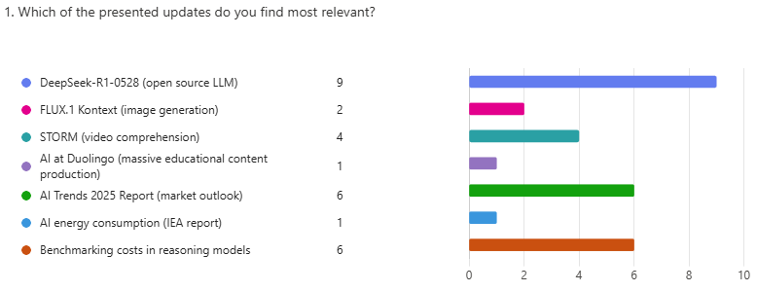
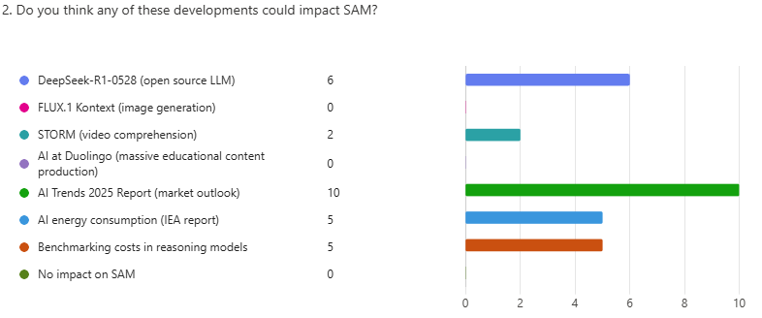
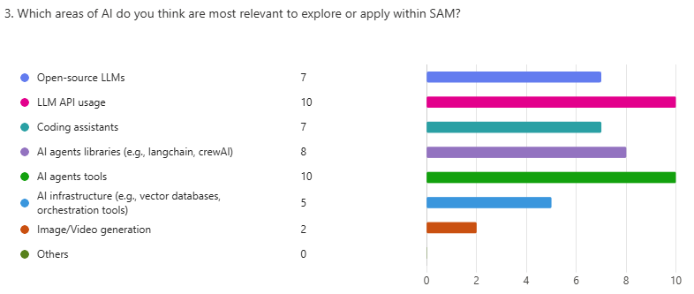
1) Survey (I)

Slide 4
1) Survey (II)
Can you think of any idea, project, or exploratory path that we could evaluate or develop within SAM based on these advances?
Answers
Investment Research Assistants.
I think process automation initiatives are already underway, so this would be most useful for those. It is also good to move in parallel with emerging developments that might arise.
Funds research, investment reports.
Develop specific AI agents for different roles within the Investments team (portfolio managers, analysts, traders, economists, etc) not only for process automation but also to help on scenario analysis and, eventually, idea generation.
Coffee Break Could be easily generated with AI tools.
Strong believer that we need a core data foundation first, however digital workers trials should be made available to as many people as possible.
Would you like to present any other AI news, your idea or comment during the meeting?
Answers
Apple's paper on LRMs (haven't read it though) -- The Illusion of Thinking: Understanding the Strengths and Limitations of Reasoning Models via the Lens of Problem Complexity.
Applying AI to management and not just to processes (by setting aside a designated time for it).

Slide 5
2) Recent updates in AI
Beyond technical progress, AI is redefining scale, cost, and speed of innovation across industries.
Foundation Models and Technical Advances in AI
Creativity and Content Generation
Market Forces, Energy & Global Trends
1) DeepSeek-R1-0528: High-Performance Open-Source AI
Open-weight models approaching the capabilities of top closed models like OpenAI’s o3 and Google Gemini.
MIT license, cost-efficient, and operable on smaller hardware setups.
4) FLUX.1 Kontext: Consistent Image Generation
Models capable of maintaining character consistency and editing across scenes.
Useful for video production, graphic design, gaming, and visual storytelling.
6) AI Trends 2025 Report (Mary Meeker)
Comprehensive analysis of AI’s explosive growth and future projections.
Highlights job disruption, investment shifts, and human-AI productivity gains.
2) STORM: Efficient Multimodal Video Understanding
Drastically reduces video tokens processed without loss of performance.
Ideal for applications in education, media analysis, and surveillance.
Real-World Applications and Industry Transformation
7) AI and Energy Consumption (IEA)
Dual narrative: AI increases energy demand but also enables significant energy savings.
Urges strategic planning for sustainable infrastructure and regulatory frameworks.
5) Duolingo: AI-Powered Expansion of Language Learning
Used generative AI to scale from 100 to 148 language courses.
Achieved personalization and multilingual rollout in record time.
3) Benchmarking Reasoning Models: Rising Costs
Costs for evaluating complex reasoning models are rising steeply.
A challenge for reproducibility and independent validation, especially for smaller labs and startups.

Slide 6
2.1) Recent updates in AI - DeepSeek-R1-0528: High-Performance Open-Source AI
DeepSeek has launched the latest version of its open-weight model, DeepSeek-R1-0528, approaching the performance of top-tier closed models like OpenAI o3 and Gemini-2.5 Pro.
Flagship model: 685B parameters (Mixture-of-Experts), 64k input/output tokens.
Performance: Dramatic improvement in reasoning (+9 points on HLE) and programming tasks (+18 points on Aider).
Compact version: DeepSeek-R1-0528-Qwen3-8B excels in its size class and runs on a single GPU.
MIT Open License: Available on Hugging Face for commercial and non-commercial use.
Why it matters: Closes the gap between open and closed models, democratizing access to high-performance AI at lower cost.

Slide 7
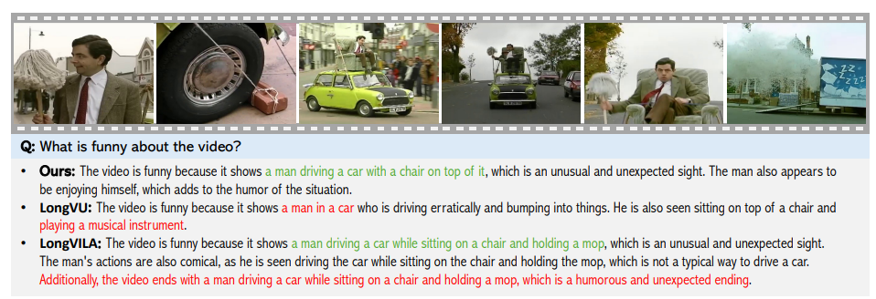
2.2) Recent updates in AI - STORM: Efficient Multimodal Video Understanding
Researchers from Nvidia and top universities developed STORM, a system that enhances video understanding while reducing token usage by 87.5%.
Technical innovation: Uses “mamba” layers to capture redundant frame information without losing detail.
Results: Outperforms models like GPT-4o and Qwen2-VL in benchmarks like MVBench and MLVU.
Speed: 3x faster than traditional systems with better performance.
Links:
[2503.04130] Token-Efficient Long Video Understanding for Multimodal LLMs
Why it matters: A significant step toward more efficient multimodal models, applicable to surveillance, education, media, and beyond.

Slide 8
2.3) Recent updates in AI - Benchmarking Reasoning Models: Rising Costs
Artificial Analysis lab published data on the rising cost of evaluating reasoning-capable models—crucial for startups and research centers.
Rising costs: Evaluating models like OpenAI o1 can exceed $2,700, versus $100–$200 for simpler models.
Reason: Reasoning models generate more tokens and require more inference steps.
Trend: As models and tasks grow in complexity, independent benchmarking becomes increasingly expensive and critical.
Why it matters: Transparent performance metrics are becoming costlier. Without open and independent evaluations, real comparison between models becomes harder.
Links:
The rise of AI 'reasoning' models is making benchmarking more expensive | TechCrunch

Slide 9
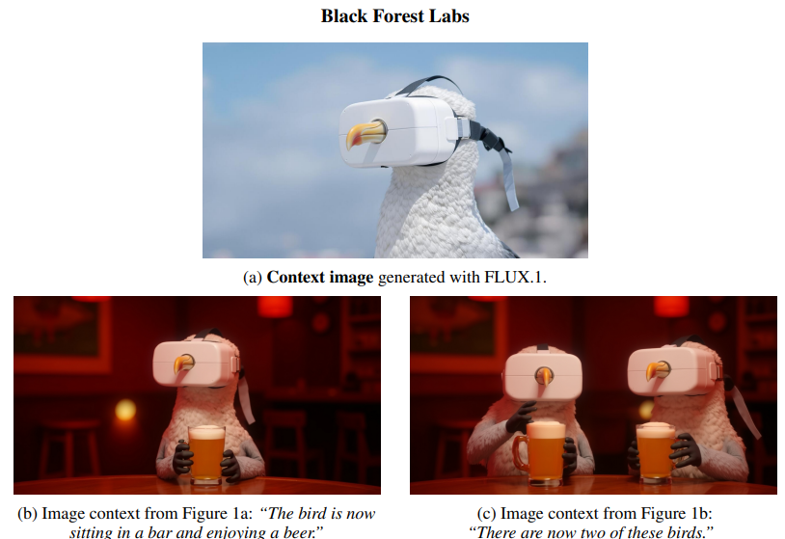
2.4) Recent updates in AI - FLUX.1 Kontext: Consistent Image Generation
Black Forest Labs has launched a new family of text-to-image models that excel at maintaining character consistency across images and allowing detailed edits.
Models: FLUX.1 Kontext max, pro, and dev (the latter will have open weights).
New Features: Local and global image modifications, style and character consistency.
Performance: Outperforms models like OpenAI’s GPT-Image 1 and Google’s Gemini 2.0 in proprietary benchmarks.
Implications: Enhances creative and design applications by enabling coherent visual narratives.
Why it matters: Advances in precise editing and visual consistency reinforce AI’s role in professional creative tools and content generation.
Links:
Black Forest Labs - Frontier AI Lab
880b072208997108f87e5d2729d8a8be481310b5.pdf

Slide 10
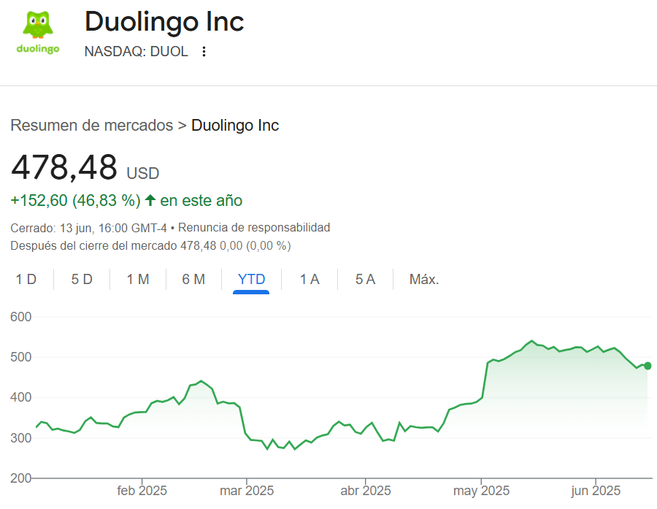
2.5) Recent updates in AI - Duolingo: AI-Powered Expansion of Language Learning
Duolingo has more than doubled its course catalog—from 100 to 148—by using generative AI for translation and content adaptation.
Expansion: Popular courses (French, Japanese, Mandarin) now available in 28 languages.
Agility: Course production that once took years now takes only months.
AI at the core: Uses models like GPT and Claude to create educational content, including for math.
Workforce impact: Automates repetitive tasks, focusing hiring on technical roles.
Links:
Duolingo Launches 148 New Language Courses - Duolingo, Inc.
Duolingo said it just doubled its language courses thanks to AI | The Verge
Why it matters: A real-world case of how AI accelerates scalability and personalization in digital education.

Slide 11
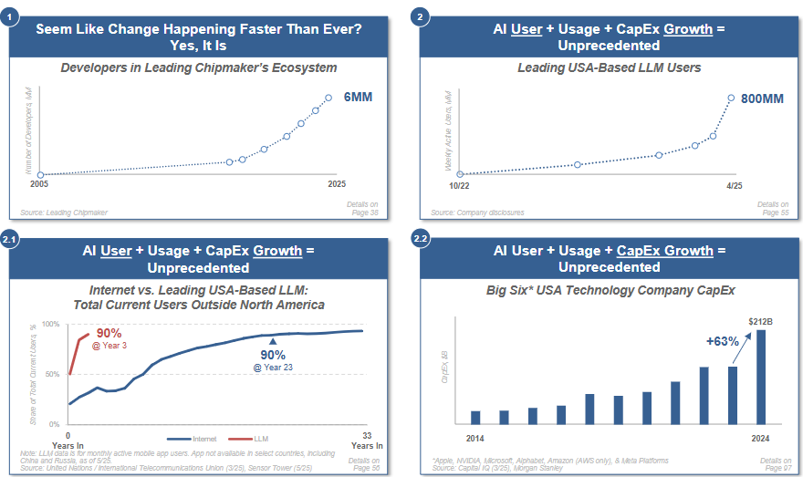
2.6) Recent updates in AI - AI Trends 2025 Report (Mary Meeker)
Mary Meeker returns with a 340-page report on the evolution of the AI market, highlighting opportunities for both value creation and destruction.
Explosive growth: ChatGPT reached 800M users. Big tech CapEx rose 63% in one year.
Mixed economics: Revenues and capabilities are up, but so are computational costs.
Technical progress: AI is outperforming humans in language benchmarks and generating highly realistic images, video, and audio.
10-year outlook: From today’s tutors and assistants to scientific breakthroughs and immersive digital worlds within a decade.
Workforce impact: Major disruption expected in financial services, legal, software, healthcare, and media. Average productivity boost with AI is 14%.
Why it matters: A clear call to prepare strategically—develop talent, adopt an AI-first mindset, and anticipate sector-wide disruptions.
Links:
Report: BOND | BOND

Slide 12
2.7) Recent updates in AI - AI and Energy Consumption (IEA)
The International Energy Agency (IEA) warns of exponential energy consumption by AI-driven data centers, but also highlights AI’s potential to save energy.
Projected consumption: Global data center electricity usage expected to double by 2030.
Risks: Strain on local power grids, especially in the U.S., China, and Europe.
Opportunities: Energy optimization in buildings, industry, and transport; renewable integration; more efficient hardware.
Expected outcome: Efficiency gains could cut emissions by up to 5x the projected growth.
Links:
AI is set to drive surging electricity demand from data centres while offering the potential to transform how the energy sector works - News - IEA
Why it matters: AI is both a challenge and a solution in the global energy transition.

Slide 13
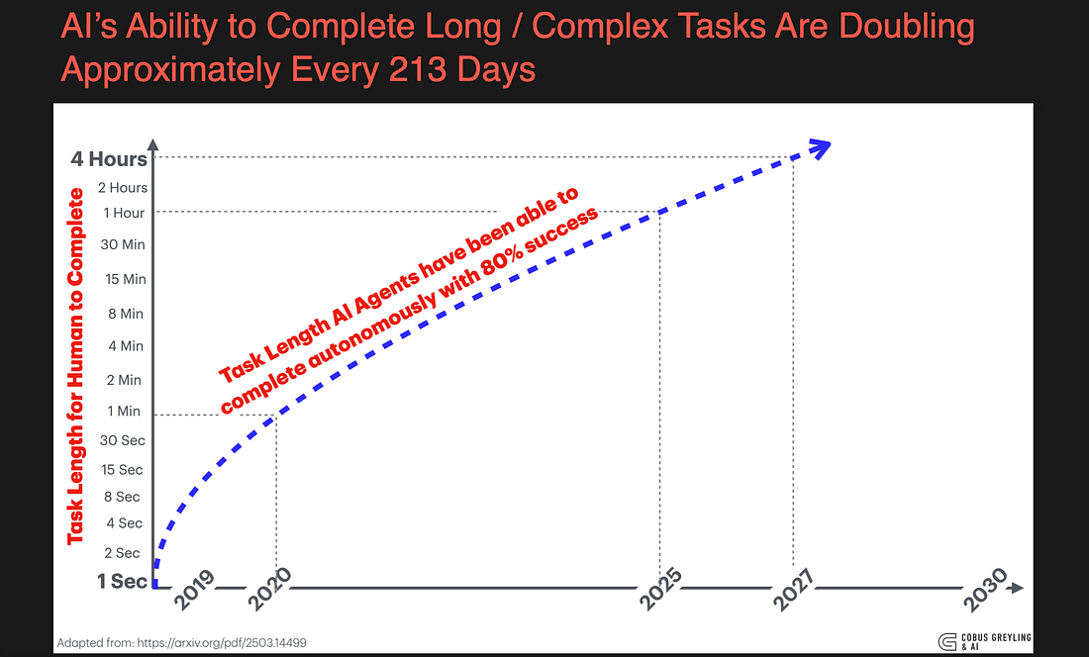
3.1) AI agents' accuracy – Article conclusion
AI agents are powerful, but their successful deployment requires careful consideration of task fit, supervision needs, and cost-performance tradeoffs. For critical business contexts, these factors must be weighed to ensure reliability and avoid unintended consequences.
Link: The Harsh Reality About AI Agents and Accuracy

Slide 14
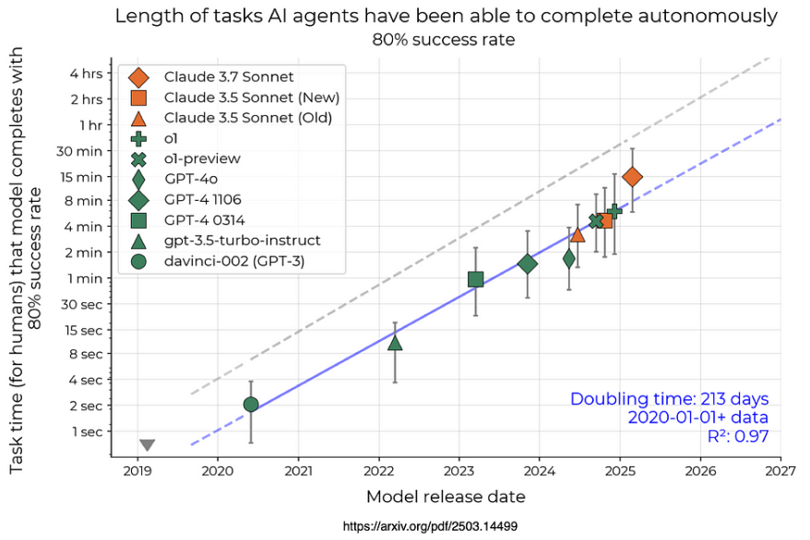
3.1) AI agents' accuracy - Task-Dependent Accuracy
AI agents perform better on narrow, well-defined tasks and struggle with ambiguous or multi-step instructions.
Tasks that require interpretation, reasoning or multiple sequential actions often expose limitations in the agent’s ability to maintain context and execute reliably.
Even the best-performing agents benefit from human monitoring to ensure correctness and catch deviations.

Slide 15
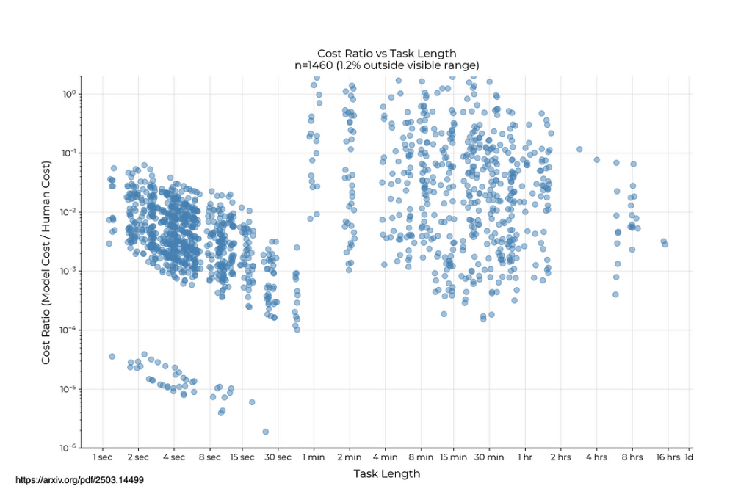
3.1) AI agents' accuracy - Cost vs. Accuracy Tradeoff
Improved accuracy often requires significantly more compute and time, increasing operational costs.
Organizations must weight the business value of precision against resource constraints — especially relevant when scaling up agent-driven solutions.
The graph suggests that AI is generally more cost-effective than humans for shorter tasks, but as task duration increases, the cost advantage of AI decreases, with costs being more comparable for tasks that take several hours or an entire day.

Slide 16
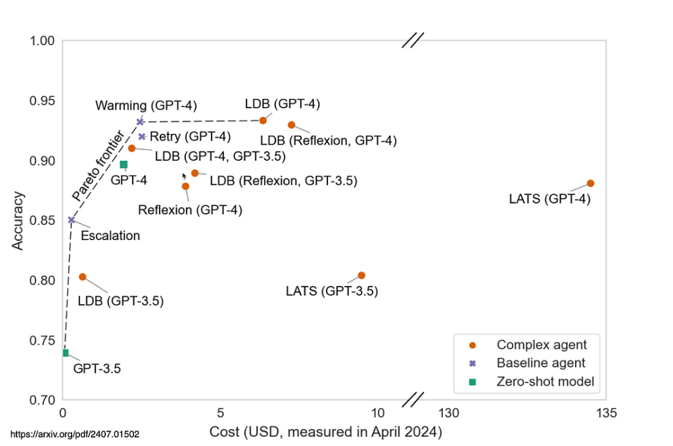
3.1) AI agents' accuracy - Rapid Innovation Meets Practical Limits
Technology is advancing fast, but current agents still face limitations in accuracy, autonomy, and robustness.
Complex workflows require memory, adaptive reasoning, and error recovery — areas where current AI agents still fall short under real-world conditions.
While the pace of improvement is encouraging, organizations must temper expectations and adopt agents gradually and strategically.

Slide 17
4) Takeaways (I)
General discussions
Reasoning models, while powerful, significantly increase processing costs—especially when prompts are complex or involve multiple tasks.
It should be considered the trade-off between using advanced agents and the efficiency of human execution for complex tasks, noting that humans often still outperform AI in such scenarios.
Open-source nature offers freedom from vendor lock-in but raises implementation challenges:
Computational demand exceeds SAM’s internal capabilities.
Quantized versions pose cybersecurity risks if not vetted by official providers.
Interest in using models like Mistral, but access and trust issues remain unresolved.
Skills and Training Needs
Call for internal training and knowledge-sharing about prompt engineering best practices. → Next Step: We will circulate for the next session technical resources and frameworks to align skill levels across regions.
Infrastructure Challenges
Include in the perimeter of the Global Data Platform (GDP) a vector database.
Desire to build or gain access to GDP.

Slide 18
4) Takeaways (II)
AI Use Cases from Participants
Research Processing (Mauro Vazquez): Rapid analysis of third-party research.
Narrative Structuring (Tom Newman): Use of custom AI to synthesize macroeconomic and geopolitical information, creating narrative frameworks akin to expert economists. Tom sees this kind of model as an aspirational benchmark for SAM's AI development efforts.
Guillermo Mestre emphasized the potential value of open-source LLMs, noting they provide an affordable and flexible opportunity to experiment with powerful models without relying on costly commercial providers. However, he highlighted technical limitations, stating that models with hundreds of billions of parameters may exceed the computational capacity of SAM’s infrastructure.
Miguel Costa presented a use case centered on improving the productivity of portfolio managers by automating the explanation of complex portfolio construction processes. He envisions an AI agent tailored to digest strategic asset allocation (SAA), client constraints, and tactical signals to generate narratives that can be presented to clients.
Investment Insights (Lucas Gragnani): His team has developed GPTs for equity stock selection, earnings analysis, and initiation research in Brazil.
Next Step: Gather and present compelling, differentiated use cases in next session.

Slide 19
Gracias
Thank you

